Slide 1


The Academic Advising Center
Michelle L. Johnson, Ed.D.
Director, Academic Advising Center

Slide 2
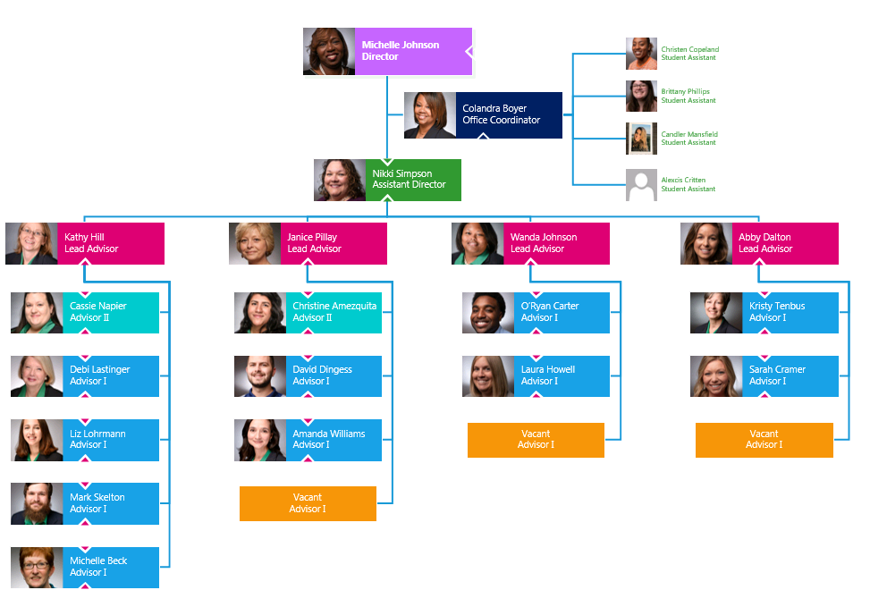
Center for Academic Advising
Centralized Structure

Slide 3
Centralized Structure: Clusters
GC provides a centralized, professional advising experience in Lanier Hall.
With professional advisors located in one building and representing every major, students can receive guidance in a one-stop setting.
The average student changes majors three or four times before finalizing his/her decision.
Our professional advisors also teach or support the First Year Academic Seminars, which increases the amount of contact between advisor and student.
Advising sessions are required each semester for academic advisors and students to review the student's degree progress.
***Faculty Advisory Council for Academic Advisement

Slide 4
Fall 2019 Academic Advising Snapshot
POUNCE Forms 1500
First day of Classes Drop-ins 317
Average weekly appointments 986 (9862)
FYS Sections 52
Academic Expo 1260
Major/Minor Declaration Days 291
First day of Spring 2020 Registration 350

Slide 5
Connection to Momentum Year
Academic Focus Areas
  Each major is tied to a focus areas
    Students that choose undeclared must also designate a focus area
    The focus area allows advisors to make sure students are taking appropriate core courses
    Example: MATH 1113 or higher for STEM focused students
  The focus area was introduced on the POUNCE form in Fall 2017
    GC has experienced a degree in the number of student entering as undeclared
      Fall 2017: 211 students
      Fall 2018: 105 students (50.23% decrease from 2017)
      Fall 2019: 116 students (45.02% decrease from 2017)

Slide 6
Connection to Momentum Year
Key Academic Milestones
  Academic advisors register students for the first term and help students create academic plans in First-Year Seminar. They are able to ensure that students are:
    Completing core English by 30 hours
    Completing the correct Area A Math course
    Taking courses in their selected major
    Completing 30 credit hours

Slide 7

Advising = Retention = Persistence = Degree Completion
Academic advising exerts a significant impact on student retention through its positive association with, and mediation of, variables that are strongly correlated with student persistence, namely:
(1). Student satisfaction with the college
experience
(2). Effective educational and career planning and decision making
(3). Student utilization of campus support services
(4). Student engagement outside the classroom, and
(5). Student mentoring
Drop-in Advising Center and Peer Advising

Slide 8

Conditions of Excellence in Academic Advising
Student Purpose and Pathways
Academic Maps must be coherent, enrich students’ programs of study, and support their educational goals, career and life aspirations. Partners and key stakeholders collaboratively and closely examine all student transitions and develop policies and practices to overcome barriers and optimize learning and success. Model: Appreciative Academic Advising
Equity, Inclusion, and Diversity
It encourages individual and institutional conversations that promote understanding, respect, and honor diverse perspectives, ideas, and identities. Academic advising policies and practices reflect a commitment to equity, inclusion, and diversity.
Technology Enabled Advising
EAB NAVIGATE-A comprehensive student success management system that links administrators, faculty, and advisors in a coordinated care network to support students from First-Year to graduation.

Slide 9
Student Success’s Web of Connection
Institutional
Commitment
Centralized Academic Advising
Student Success Center
(Affective Ties)
GCS Journeys
Campus Collaboration and Communication
Faculty advisement Council
Academic Advisement Team
Advisor Development
EAB
Academic Support
Learning Center
First-Year Seminar
Strategic Planning
Academic Advisement Plan
Degree Planning Software
Predictive Modeling
Advising Roles/Responsibilities
Academic
Advising Web of Connection

Slide 10

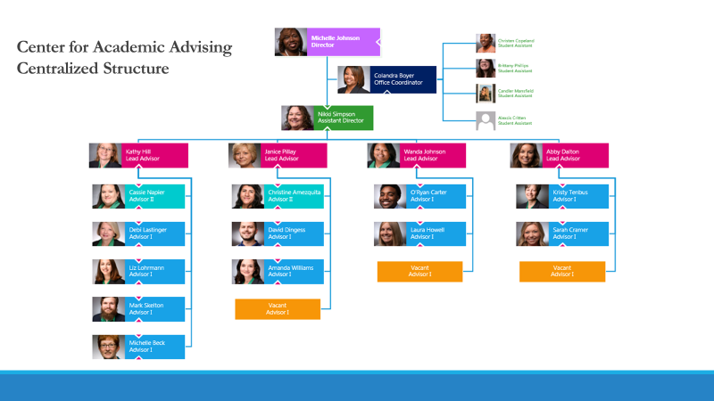
Questions?

