Slide 1
GC MENTAL HEALTH
University Senate
February 26, 2021

Slide 2
GC MENTAL HEALTH
System-wide Mental Health Initiative
Clinical Support and Resources
Strategic Planning
Mini-Grants

Slide 3
GC MENTAL HEALTH PLANNING TASK GROUP
Shawn Brooks – Point of Contact Steve Wilson – Counseling Services
Angie Childre – Student Health Services Lee Gillis – Psychology
Tom Miles – Dean of Students Michelle Johnson- Academic Advising
Susan Kerr – Information Technology Brett Stanelle – Public Safety
Emily Jarvis – Parent & Family Programs Lori Burns – Residence Life
Keely Hopkins – Communications David Anderson – Disability Resources
Nadirah Mayweather – Cultural Center Jordan Kyles – Athletics
Stacey Milner – Fraternity & Sorority Life
Rachel Pope – Health Educator

Slide 4
Clinical Support and Resources

Slide 6
Christie Campus Health

Slide 7
NEW MENTAL HEALTH RESOURCES FOR STUDENTS
A 24/7/365 mental health support line for in-the-moment support and linkages to next steps, regardless of time of day or your location.

Slide 8
NEW MENTAL HEALTH RESOURCES FOR STUDENTS
No cost Telehealth sessions provided by a diverse network of licensed mental health clinicians.
Virtual Psychiatric Clinics to offer assessment and medication management.

Slide 9
NEW MENTAL HEALTH RESOURCES FOR STUDENTS
Personal Student Navigators to assist with referral coordination and support.
A Self-directed iCBT program designed exclusively for students.

Slide 11
HTTPS://GCSU.EDU/GCMENTALHEALTH

Slide 12
Wellness hub
“The Wellness Hub” which includes an App and an online wellness magazine with educational content, self-help tools and resource links.

Slide 13
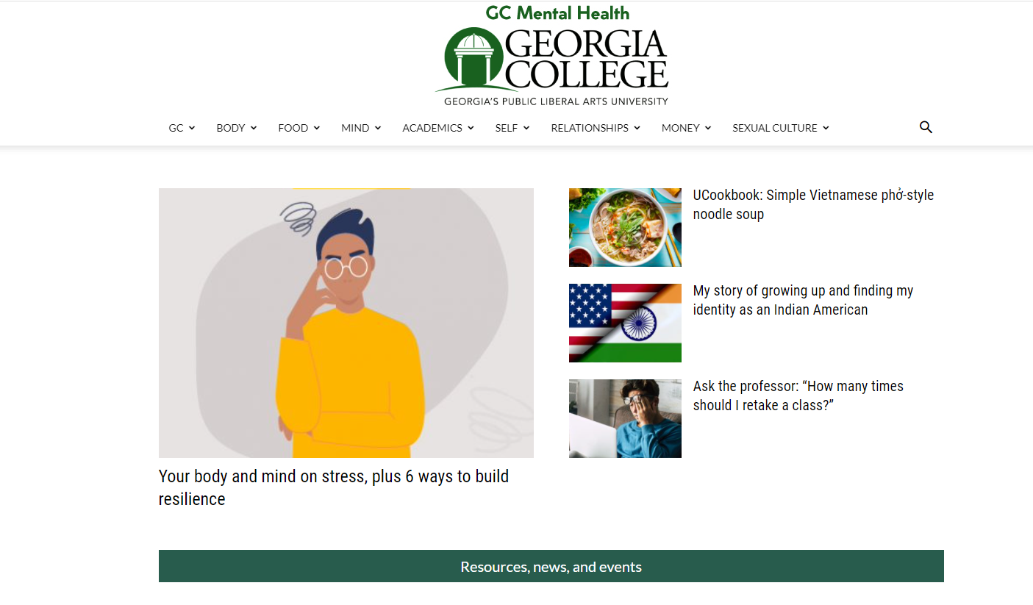
NEW MENTAL HEALTH RESOURCES FOR STUDENTS
“The Wellness Hub” which includes an App and an online wellness magazine with educational content, self-help tools and resource links. To access the www.gcwellnesshub.com or download the app in the Apple Store or Google Play.

Slide 17
STRATEGIC PLANNING
JED FOUNDATION/JED CAMPUS

Slide 18
Jed Foundation and Jed Campus
The Jed Foundation (JED) is a non-profit organization that protects emotional health and prevents suicide for teens and young adults in the United States.
JED Campus is a nationwide initiative designed to guide schools through a collaborative process of comprehensive systems, program and policy development with customized support to build on existing student mental health, substance abuse and suicide prevention efforts.

Slide 19
MINI-GRANTS

Slide 20
GC Mental Health Mini-Grants
Professional and technical training
Kognito Virtual
Mental Health First Aid
EDMR Counselor Training
Mongoose Cadence Texting Platform

